Slide 1
Microservices
SE495: Software and Systems Integration

Slide 2
Outline
Introduction to Microservices
Microservices Architecture
Integration Patterns
Tools and Technologies

Slide 3
Introduction to Microservices

Slide 4
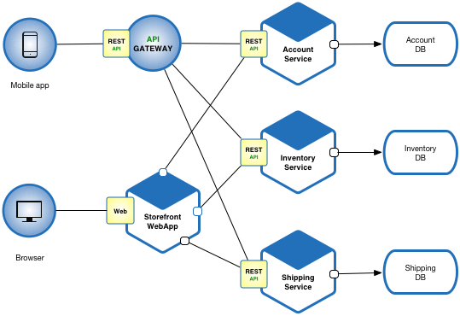
Microservices
Microservices is a software development architecture that involves breaking down a large application into smaller, independent components or services.
Each service is responsible for a specific function or feature of the application and communicates with other services through well-defined APIs.

Slide 5
What is Microservices?
“Microservices are a thing these days.”
Phil Calçado, former Director of Engineering, SoundCloud
“Microservices are small, autonomous services that work together.”
Sam Newman, Thoughtworks
“Loosely coupled service-oriented architecture with bounded contexts.”
Adrian Cockcroft, Battery Ventures
“A microservice is an independently deployable component of bounded scope that supports interoperability through message-based communication.”
“Microservice Architecture-Aligning Principles, Practices, and Culture”

Slide 6
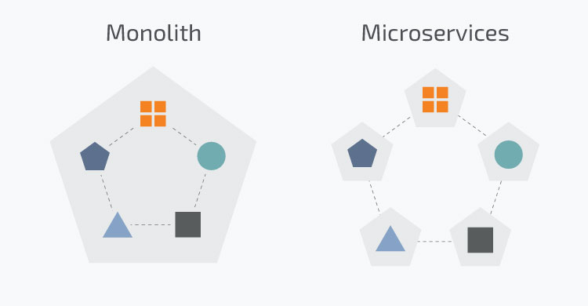
Microservices
Traditionally applications were built in a monolithic architecture style
Single unit with client-side apps, server-side apps and a database managed and served in one place
However, modern applications are built in a microservices architecture
Smaller, independent units that carry out every application process as a separate service

Slide 7
Why use Microservices?
Independent components that can be updated and deployed separately
A bug in one microservice does not impact any other microservice
Easier to understand and manage small units of code
Better scalability as each unit can scale independently
More freedom in tech selection as each microservice can use a different language and framework
But increase in complexity as each microservice needs to be able to talk to each other

Slide 8
Benefits of using microservices
Scalability
They are easier to scale individual components of an application independently
Flexibility
They allow developers to use different technologies and programming languages for different components of the application
Resilience
Failures in one service do not impact the entire application
Faster development and deployment
Microservices can be developed and deployed independently
Improved team collaboration
They encourage smaller, more focused development teams that can work more independently and collaboratively

Slide 9
Drawbacks of using microservices
Increased complexity
They add additional complexity to the development and deployment process, as multiple services must be developed, tested, and deployed independently.
Integration challenges
Because microservices are developed independently, there can be challenges in integrating them with other services and ensuring that they work together seamlessly.
Increased operational overhead
Managing multiple services can be more complex and require more resources than managing a single monolithic application.
Testing challenges
Testing microservices can be more complex than testing a monolithic application, as each service must be tested independently and in conjunction with other services.
Performance overhead
Because microservices communicate with each other over APIs, there can be additional performance overhead compared to a monolithic application that has direct access to all components.

Slide 10
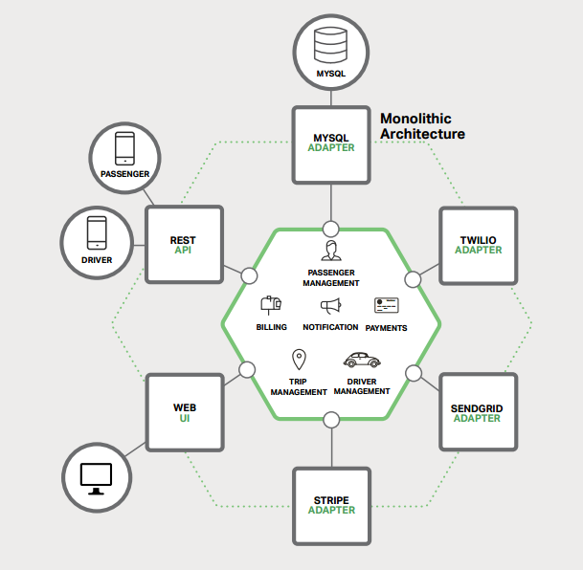
Building Monolithic Applications

Slide 11
Building Monolithic Applications
These applications are simple to test and debug.
These applications are also simple to deploy.
These applications are scalable.

Slide 12
Issues with Monolithic Applications
In time the application become too complex.
Being too large is very difficult for any developer to fully understand.
A large application is an obstacle to continuous deployment.
Another problem with monolithic applications is reliability.

Slide 13
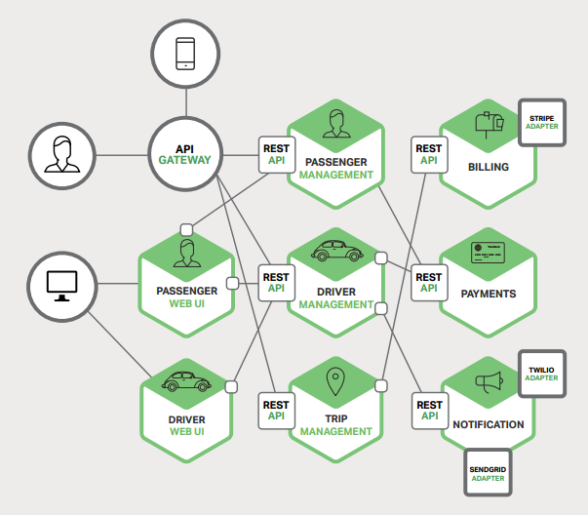
Microservices – Tackling Complexity

Slide 14
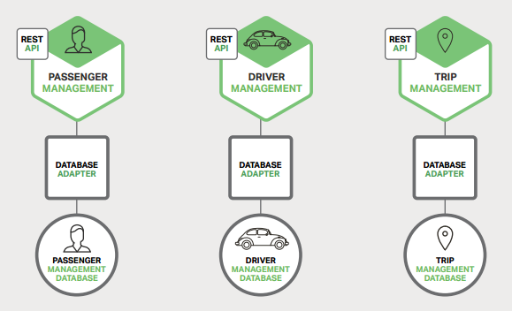
Microservices – Tackling Complexity

Slide 15
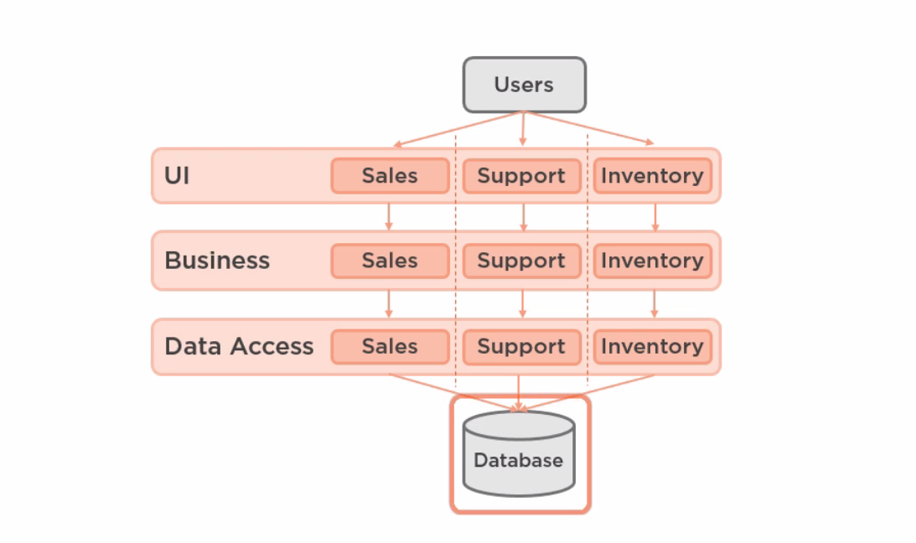
Why Microservices

Slide 16
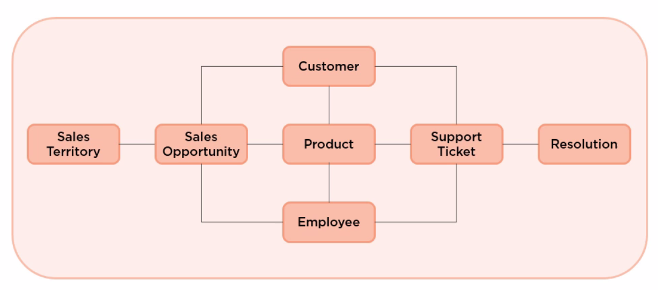
Why Microservices

Slide 17
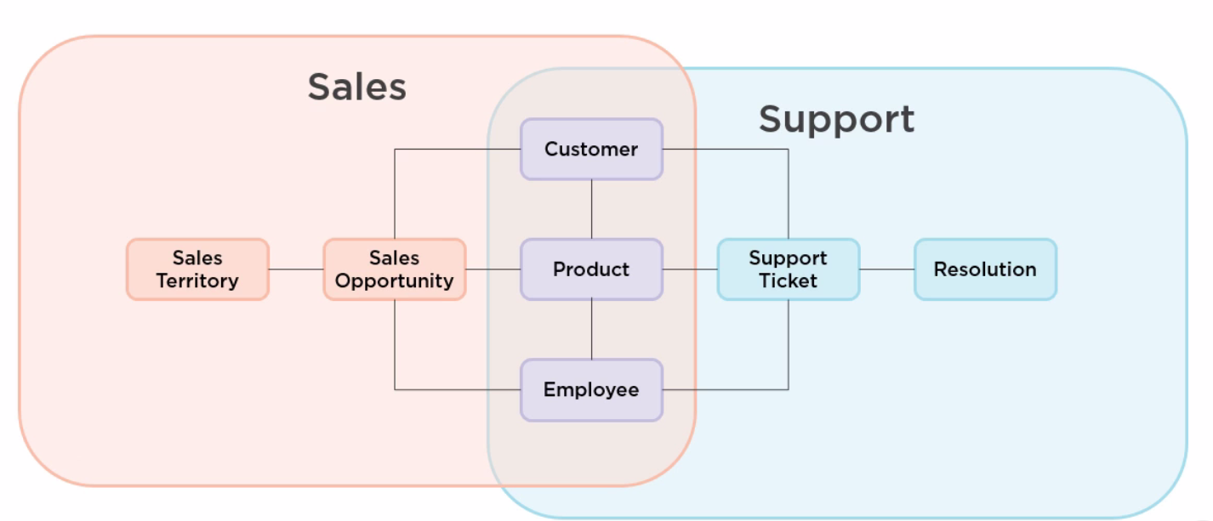
Why Microservices

Slide 18
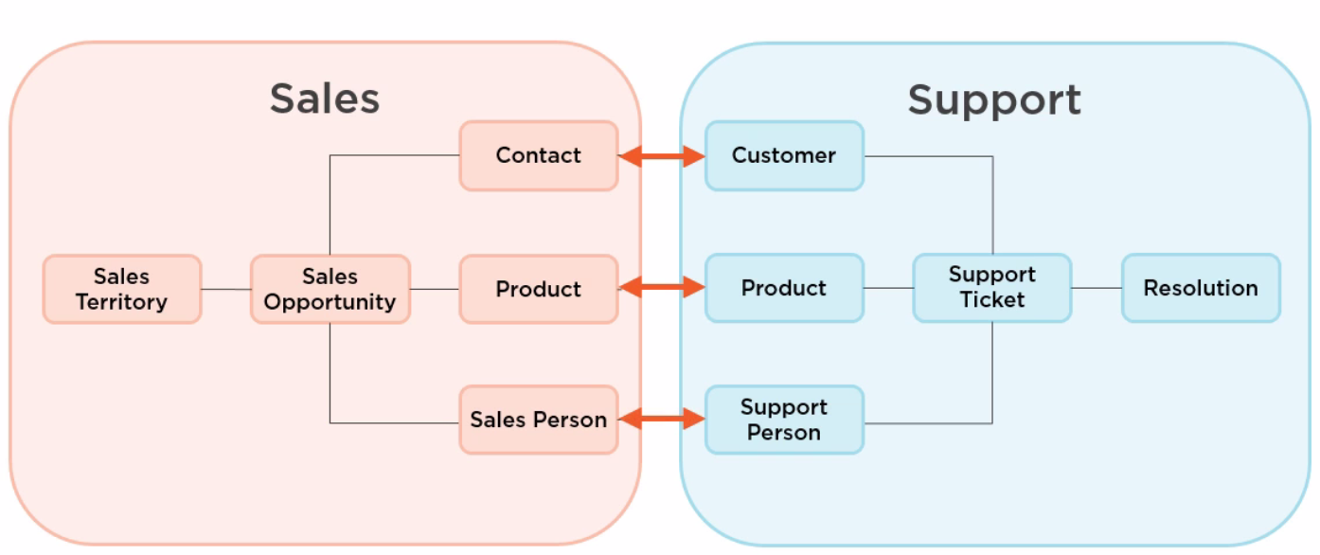
Why Microservices

Slide 19
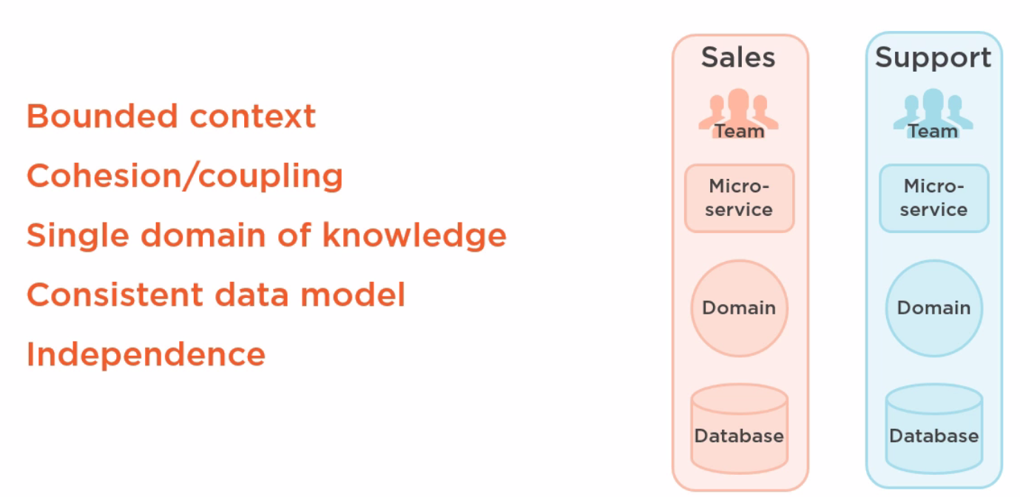
Why Microservices

